Slide 1
Segmentation & Path To Purchase
12.10.2014
Notes:
Share a few new slides on emotional drivers and personality traits
Tie in hobbies

Slide 2
60 Million
# of households considering buying a new grill
Notes:
Goal
14 Million sold
How can we encourage

Slide 3
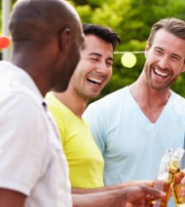
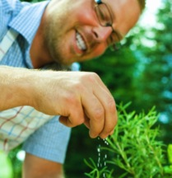
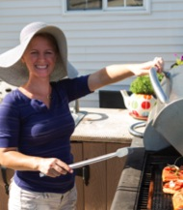
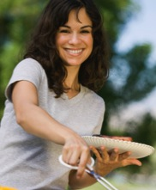
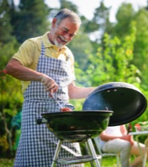
Behavioral Segmentation
EXPERIENCE
EASY
TRADITION
 | Crowd Pleasers | Striving Sizzlers | Mavericks | Dashing Diners | Green-Horn Grillers | Old Man Charcoal
 | Sociable male. Grilling is all about having fun with friends and family. Not a big risk taker or big spender. | Grilling is a labor of love and he’s giving it all he’s got to make the most of his backyard meals. He doesn’t mind putting forth the extra effort to try new dishes and sweats it out so he can feel like “the man” when he’s created something special. | Younger male, most diverse segment, confident griller. Loves the outdoors and the experience is as important as the food. Skews highest on innovative tech. | Not a grill enthusiast, per se but knows that grilling is the most convenient way to get a meal on the table. Skews slightly female. Gas grills only please. | This is our beginner segment. May cook often in the kitchen but not yet comfortable on the grill. Likes to cook healthy, and she does enjoy relaxing outside while using her grill. | Old-school, old man. All about the taste and he gets it from his charcoal grill.
 | 6% | 25% | 27% | 9% | 18% | 14%

Slide 4
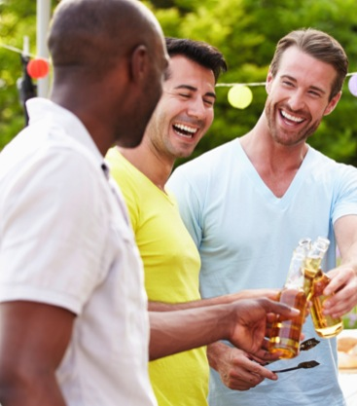
Crowd Pleasers
PSYCHOGRAPHICS
100 PT ALLOCATION
I like to have fun outdoors (87%)
I like to feel confident and comfortable around the grill (75%)
My ideal vacation is more about relaxation than activity (71%)
When I entertain, I feel like I am taking care of people (68%)
The experience of the grill is as important as the food (50%)
GENDER
AGE
HHI
AREA
Notes:
Older, skews slightly higher on female
Predominantly white, more likely to be rural
Upper-middle income range

Slide 5
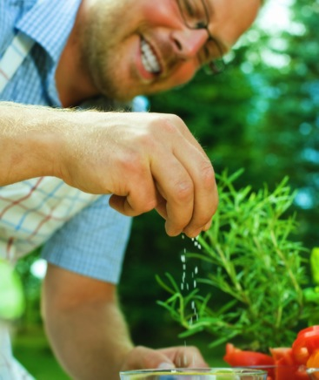
Striving Sizzlers
PSYCHOGRAPHICS
I like to have fun outdoors (83%)
I like to feel confident and comfortable when I grill (80%)
When I entertain at home, I feel like I am taking care of people (71%)
I like to grill different dishes depending on the crowd I am entertaining (67%)
I like to grill different dishes depending on the season (66%)
100 PT ALLOCATION
GENDER
AGE
HHI
AREA

Slide 6
Mavericks
PSYCHOGRAPHICS
100 PT ALLOCATION
I like to buy innovative products before mainstream consumers get them (100%)
I always try to get the best quality for what I can spend (93%)
I like to have fun outdoors (93%)
I would rather spend more time outdoors than indoors (68%)
The experience of the grill is as important as the food (66%)
GENDER
AGE
HHI
AREA

Slide 7
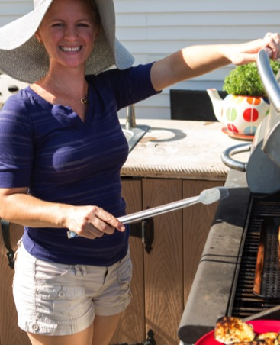
Dashing Diners
PSYCHOGRAPHICS
100 PT ALLOCATION
I like to have fun outdoors (84%)
I like to feel confident and comfortable when I grill (69%)
I enjoy attending sports events and/or concerts (63%)
Grilling is the most convenient way of cooking (61%)
The performance of a grill is related to its price (42%)
GENDER
AGE
HHI
AREA
Notes:
Older, skews slightly higher on female
Predominantly white, more likely to be rural
Upper-middle income range

Slide 8
Green-Horn Griller
PSYCHOGRAPHICS
100 PT ALLOCATION
I like to have fun outdoors (86%)
I like to share the cooking with family and friends (68%)
The outdoor space is where I relax (60%)
I like to grill different dishes depending on the crowd I’m entertaining (59%)
GENDER
AGE
HHI
AREA

Slide 9
Old Man Charcoal
PSYCHOGRAPHICS
100 PT ALLOCATION
I like to feel confident and comfortable when I grill (73%)
I don’t mind the preparation required for grilling (67%)
I am old school around the grill (57%)
I like to receive compliments when I grill (54%)
GENDER
AGE
HHI
AREA

Slide 10
Simple + Experience
Mavericks are aware that they can achieve a great experience without having to man the grill the old fashioned-way
The experience of spending time outdoors, grilling and entertaining appeals highly to the Crowd Pleasers and Striving Sizzlers
Dashing Diners and Green-Horn Grillers want to know if grilling can be easy
Experience
Simplicity
Notes:
Simple – Index of convenience and old school, Innovation
Experience – I’d rather spend time outdoors and 100 pt Experience, Entertaining at home

Slide 11
How Confident Are They?
How would you describe yourself as a griller?
Master
Griller
experienced
engaged
Mavericks skew highest on confidence
Crowd Pleasers claim the most master-grillers
Dashing Diners and Green-Horn Grillers have less confidence in their skills
Green-Horn Grillers are the newbies
disengaged
active
Beginner
2 3 4 5
Weekday Grilling/Month
Notes:
Mavericks are the key segment

Slide 12
Personality Traits
How would you describe yourself?
Notes:
In general

Slide 13
Emotions Associated With Grilling
Please choose up to five options that best complete the following sentence about how you feel about grilling

Slide 14
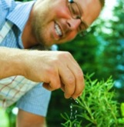
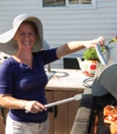
EXPERIENCE
EASY
TRADITION
 | Crowd Pleasers | Striving Sizzlers | Mavericks | Dashing Diners | Green-Horn Grillers | Old Man Charcoal
Share of Market | 6% | 25% | 27% | 9% | 18% | 14%
Male | 75% | 82% | 70% | 59% | 22% | 80%
Female | 25% | 18% | 30% | 41% | 78% | 20%
Key Attribute | Social | Labor of Love | Explorer | Convenience | Beginner | Old-School
Fuel Outlier | Char | - | - | Gas | - | Char
Share of Wallet | 5% | 24% | 33% | 10% | 15% | 13%
Fav. Store Outlier | Walmart | - | Lowe’s | Walmart/THD | Lowe’s | THD
Notes:
Money slide

Slide 15
What’s The Prime Prospect’s Problem?
Notes:
Let’s look at the path to purchase and see what we can effect

Slide 16
89%
are experienced grill buyers!
Notes:
Many are upgrading, even more are looking to replace with a similar grill
Some are buying additional grills.
What are our segments looking for and what are some of the pain points

Slide 17
Purchase Reason
Which reason best represents why you bought your last grill?
Overall, grillers say they are replacing with a similar grill 1/3 of the time, and ¼ are upgrading
Mavericks are more likely to be upgrading or buying an additional grill
Dashing Diners are upgrading as well – opportunity to sell at higher pp on speed/convenience
Only 1/8 of the time are they buying an additional grill. What can be done to improve the grills per household ratio? Why aren’t the Striving Sizzlers using additional grills as tools in their arsenal?
 | Crowd Pleasers | Striving Sizzlers | Mavericks | Dashing Diners | Green-Horn Grillers | All
I replaced my grill with a similar one | 110 | 111 | 74 | 110 | 101 | 36%
I upgraded | 77 | 93 | 129 | 121 | 83 | 25%
I bought an additional grill | 79 | 78 | 133 | 75 | 107 | 12%
It was a gift | 124 | 103 | 74 | 62 | 144 | 11%
It was my first grill/ I didn't own one before | 110 | 107 | 115 | 65 | 97 | 11%
Notes:
Overall, grillers say they are replacing with a similar grill 1/3 of the time, and ¼ are upgrading
Mavericks are more likely to be upgrading or buying an additional grill
Dashing Diners are upgrading as well – opportunity to sell at higher pp on speed/convenience
Only 1/8 of the time are they buying an additional grill. What can be done to improve the grills per household ratio?

Slide 18
Let’s look at their path to purchase
Notes:
Many are upgrading, even more are looking to replace with a similar grill
Some are buying additional grills.
What are our segments looking for and what are some of the pain points

Slide 19
Setting A Budget Often Involves Preliminary Research
How did you set your budget?

Slide 20
Twice as many spent more…
Which of the following best describes your budget situation last time you bought a grill?

Slide 21
Researching Online vs. In-Store
Time consuming process
51% of time is spent in-store
None
Notes:
2 hours online
45 mins to an hour in store
Weeks

Slide 22
Info Sources: Use vs. Importance
What information source is most important to you when learning about the grill? Select up to 5 sources you feel are most important.
Please rank the following information sources that you think is the most important when learning about the grill.
Notes:
Top 1 info source ranking

Slide 23
How Much Do They Spend?
 | Crowd Pleasers | Striving Sizzlers | Mavericks | Dashing Diners | Green-Horn Grillers | All
Share of Market | 6% | 25% | 27% | 9% | 18%
Last Grill Spend | $227.63 | $257.56 | $325.83 | $288.65 | $216.77 | $267.32
Favorite Grill Spend | $252.85 | $282.17 | $377.49 | $328.78 | $270.13 | $306.21
Parts/Accessories Spend | $71.93 | $72.78 | $90.87 | $57.57 | $60.70 | $73.37
Notes:
Weighted Avg
Part and Accessories spend tracks with how techy/gadgety they are

Slide 24
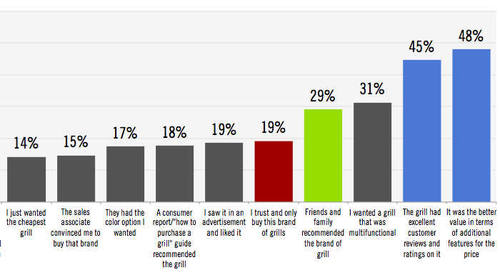
Grill Brand Purchase Decision
For the last grill you purchased, why did you select that brand? Top-5
Notes:
Age matters

Slide 25
70%
Visit multiple stores
Notes:
Opportunity to close the deal in the first visit
How can online help?

Slide 26
Why Do They Shop Around?
Why did you visit multiple stores? Top-5
Almost 1 in 4 shoppers are paralyzed narrowing down the options or overwhelmed by too many options

Slide 27
Why Do Some Visit Just One Store?
Need to drive traffic by creating a destination and then close the deal
Why did you visit just one store?

Slide 28
Store Drivers
Why did you choose ______?
Choose up to three choices that best describe your decision.

Slide 29
Where did they shop? Consideration vs. Final – Halo?
Consideration
Final
?
Notes:
Missing question

Slide 30
THANKS!

